Slide 1
MODULE 18: CASUALTY MONITORING
TCCC TIER 1
All Service Members
TCCC TIER 2
Combat Lifesaver
TCCC TIER 3
Combat Medic/Corpsman
TCCC TIER 4
Combat Paramedic/Provider

Slide 2




TACTICAL COMBAT CASUALTY CARE (TCCC) ROLE-BASED TRAINING SPECTRUM
ROLE 1 CARE
NONMEDICAL PERSONNEL
MEDICAL PERSONNEL
ASM
CMC
CPP
CLS
YOU ARE HERE
STANDARDIZED JOINT CURRICULUM
2

Slide 3
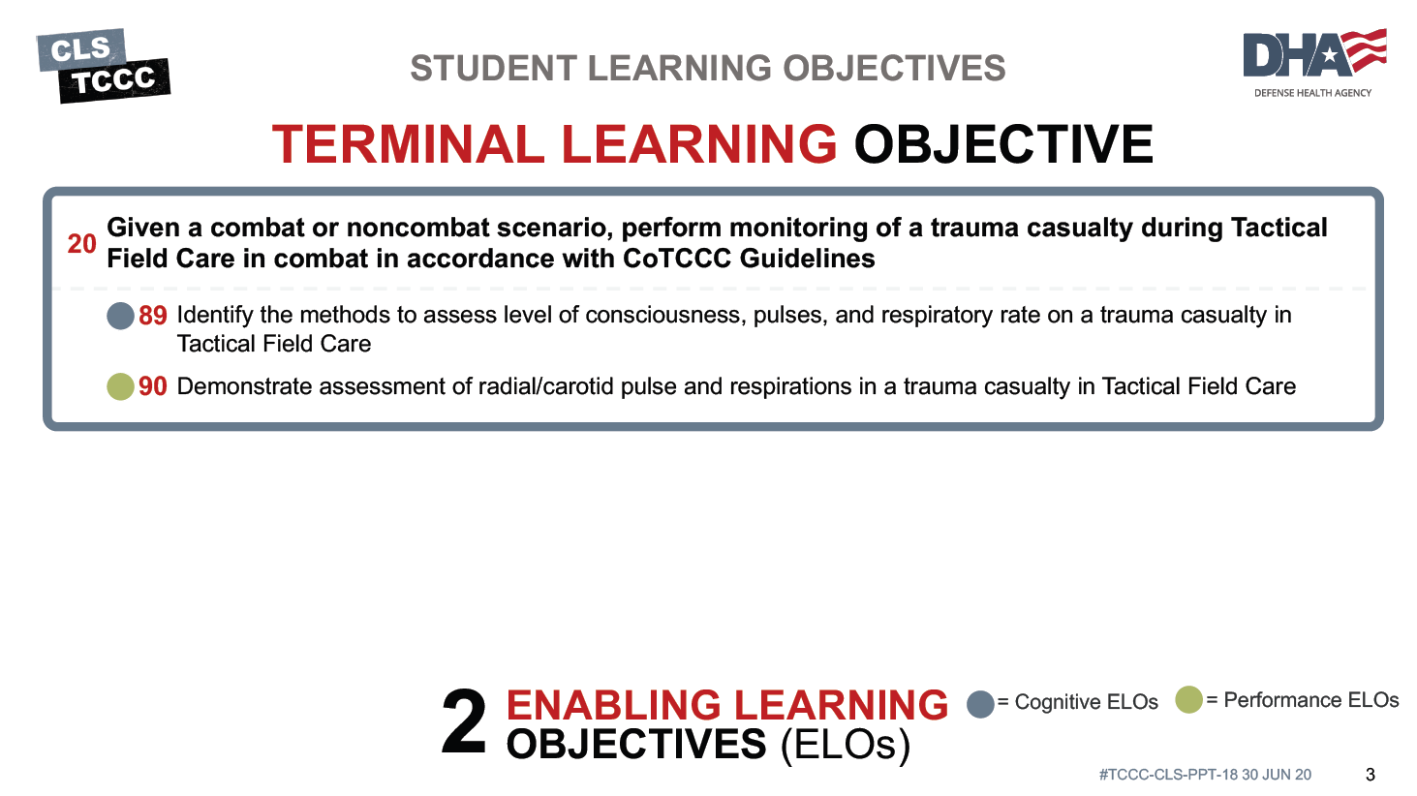




TERMINAL LEARNING OBJECTIVE
STUDENT LEARNING OBJECTIVES
₂₀ Given a combat or noncombat scenario, perform monitoring of a trauma casualty during Tactical Field Care in combat in accordance with CoTCCC Guidelines
Identify the methods to assess level of consciousness, pulses, and respiratory rate on a trauma casualty in Tactical Field Care
Demonstrate assessment of radial/carotid pulse and respirations in a trauma casualty in Tactical Field Care
2
ENABLING LEARNING OBJECTIVES (ELOs)
= Cognitive ELOs
= Performance ELOs
3

Slide 4


Three PHASES of TCCC
TACTICAL FIELD CARE
1 CARE UNDER FIRE
RETURN FIRE AND TAKE COVER
Quick decision-making:
▪ Consider scene safety
▪ Identify and control life- threatening bleeding
▪ Move casualty to safety
TACTICAL FIELD CARE
COVER AND CONCEALMENT
₃ TACTICAL EVACUATION CARE
More deliberate assessment and treatment of unrecognized
life-threatening injuries
▪ Pre-evacuation procedures
▪ Continuation of documentation
NOTE: This is covered in more advanced TCCC training!
2
Basic management plan:
Maintain tactical situational awareness
Triage casualties as required
Conduct MARCH PAWS
assessment
▪
▪
YOU ARE HERE
4
#TCCC-CLS-PPT-14 30 JUN 20

Slide 5

ASSESSMENT USING MARCH PAWS
CASUALTY MONITORING
Re-bleeding
M A R C H
MASSIVE BLEEDING
Check for re-bleeding on any previous treatments
Management
M A R C H
AIRWAY
Ensure airway remains open and unobstructed
Reassess casualty every 5–10 minutes for change in status until handoff with medical personnel

Slide 6
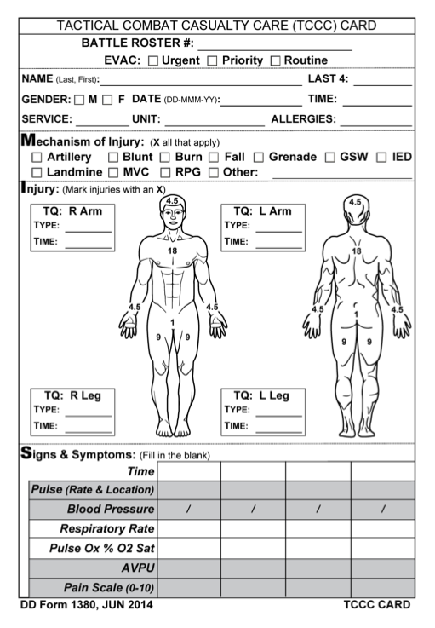
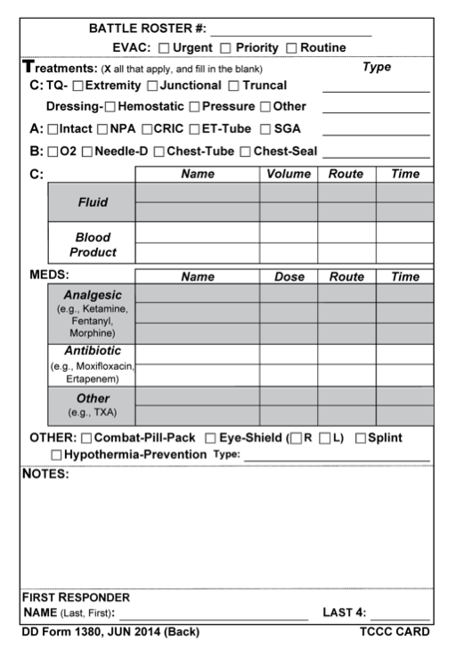
ASSESSMENT USING MARCH PAWS (CONT.)
CASUALTY MONITORING
Breathing Rate
M A R C H
RESPIRATION BREATHING
Pulse
M A R C H
CIRCULATION
Level of Consciousness
M A R C H
HYPOTHERMIA HEAD INJURIES
Document any changes in status on the casualty’s DD Form 1380
If medical personnel arrive in the middle of reassessment, stop and hand off casualty immediately

Slide 7
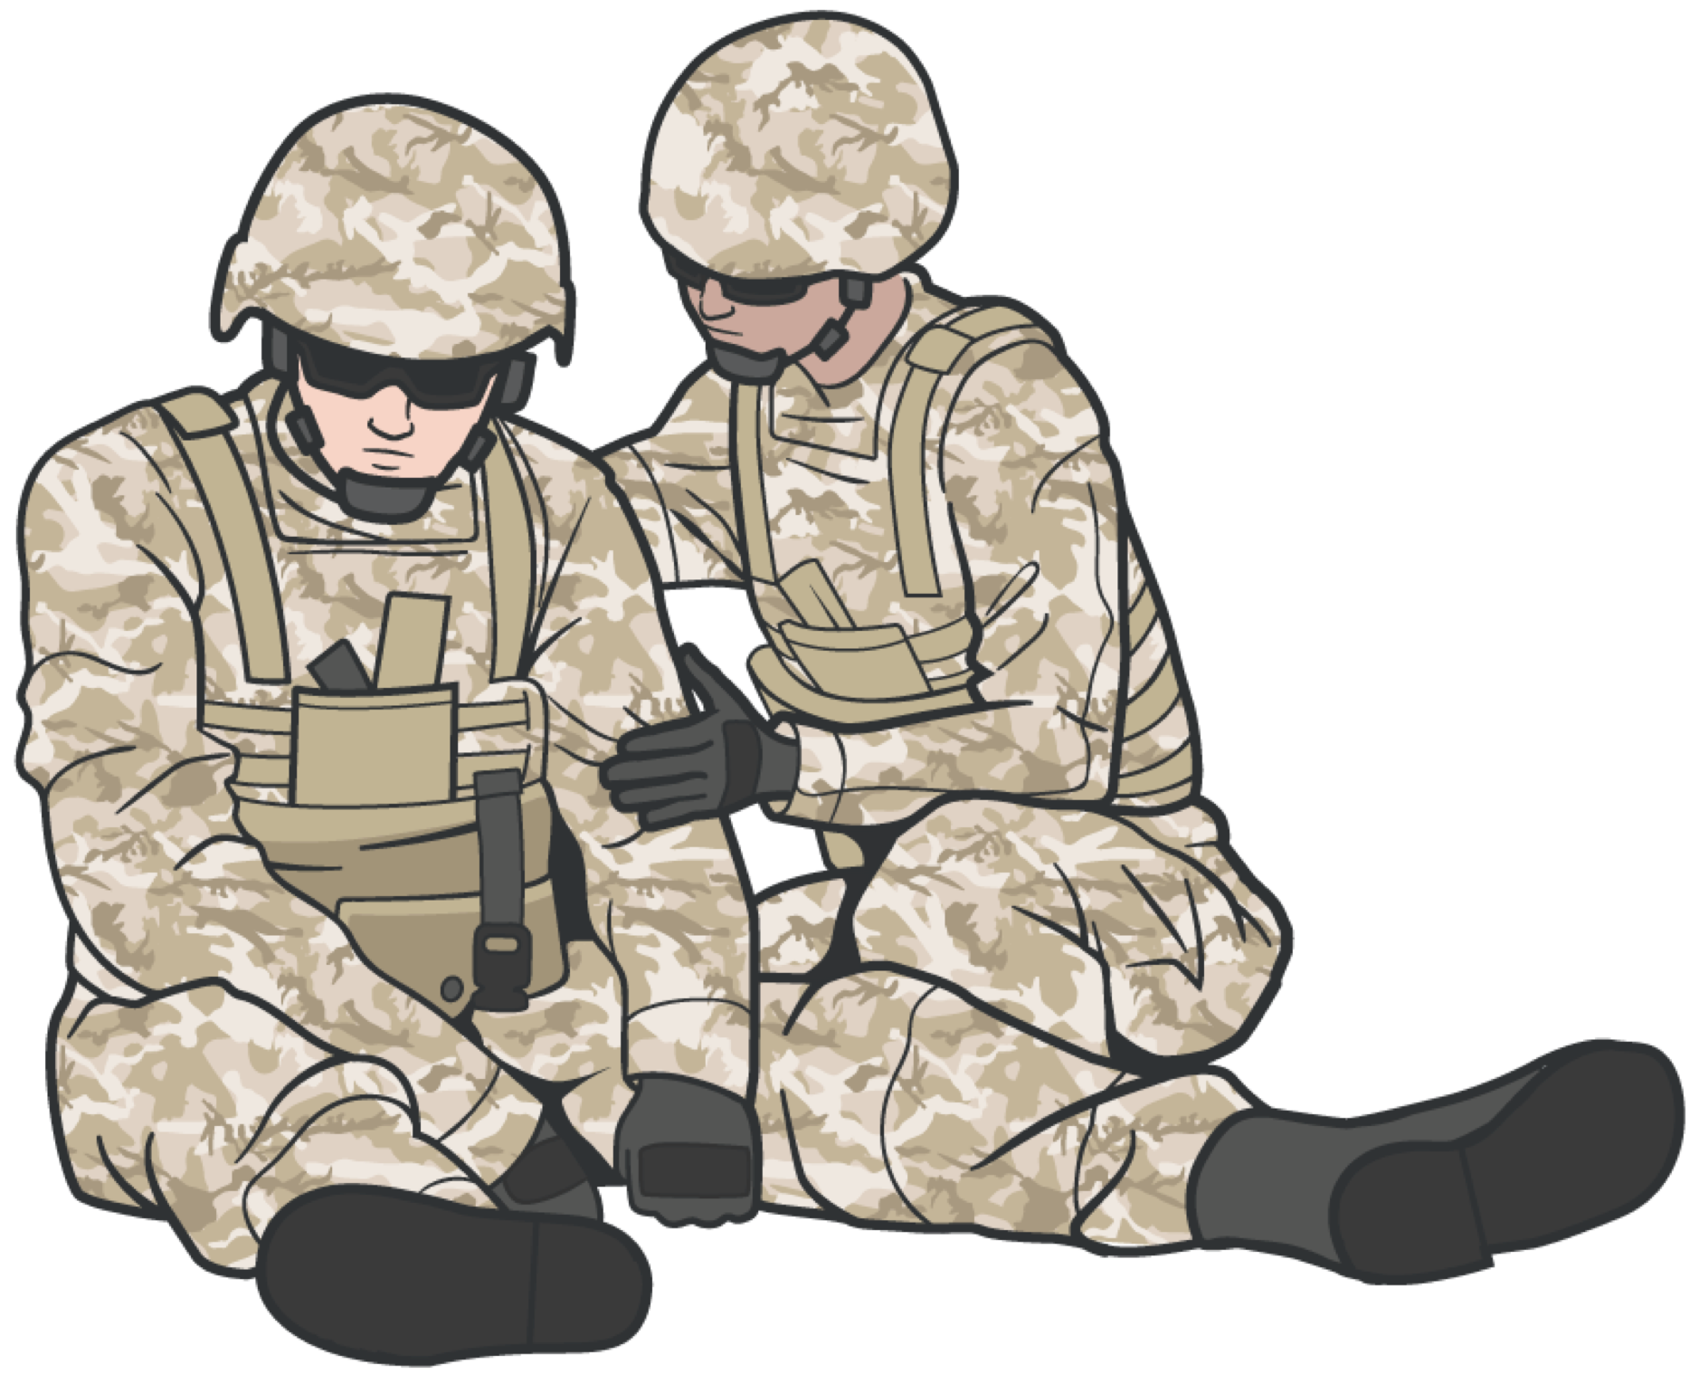

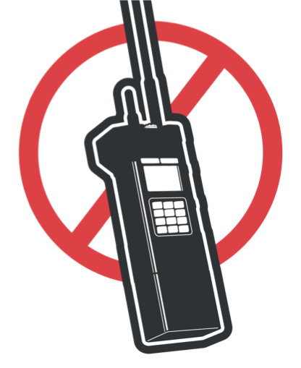
CASUALTY MONITORING
LEVEL OF CONSCIOUSNESS
Check every 15 minutes (or if seriously wounded every 5–10) for decrease in AVPU:
Alert
Verbal Pain
Unconscious
This could indicate condition worsening
If casualty is not ALERT, indicating decreased mental status, the casualty should not have weapons or communications equipment

Slide 8


CASUALTY MONITORING
AVPU ASSESSMENT HOW-TO

Slide 9
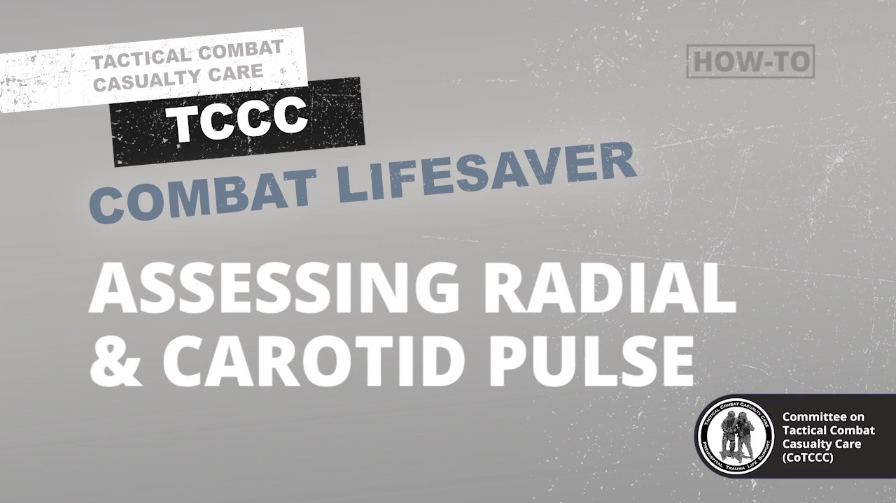
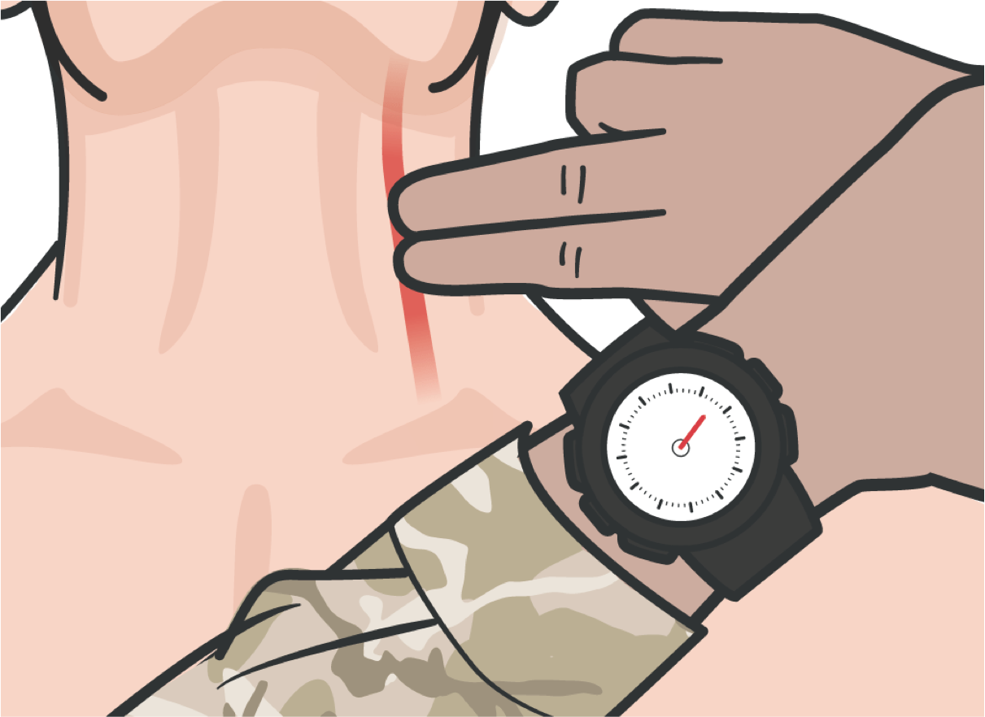
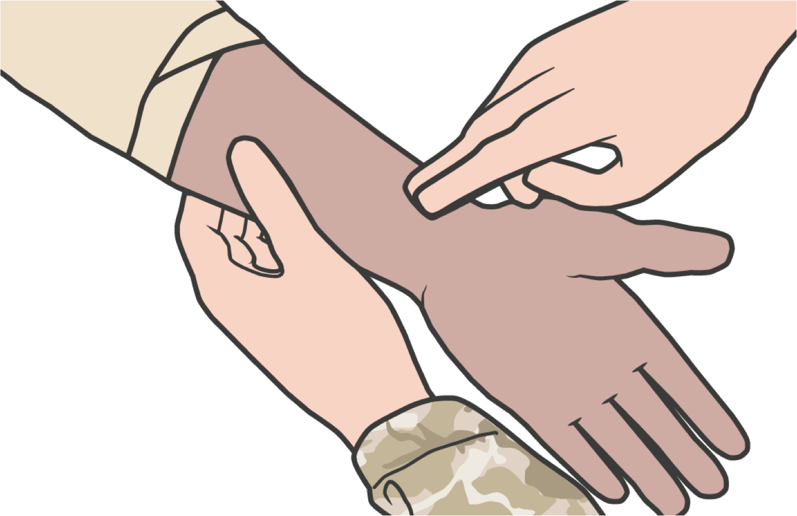
CASUALTY MONITORING
CHECKING PULSE
RADIAL & CAROTID PULSE VIDEO
Video can be found on DeployedMedicine.com
IMPORTANT CONSIDERATIONS
CAROTID (neck)
RADIAL (wrist)
Measure the number of felt heartbeats in 1 MINUTE and record on casualty’s DD Form 1380
If casualty status is noted to be deteriorating when assessed, reassess using the MARCH PAWS sequence
No radial pulse is an indicator of shock

Slide 10
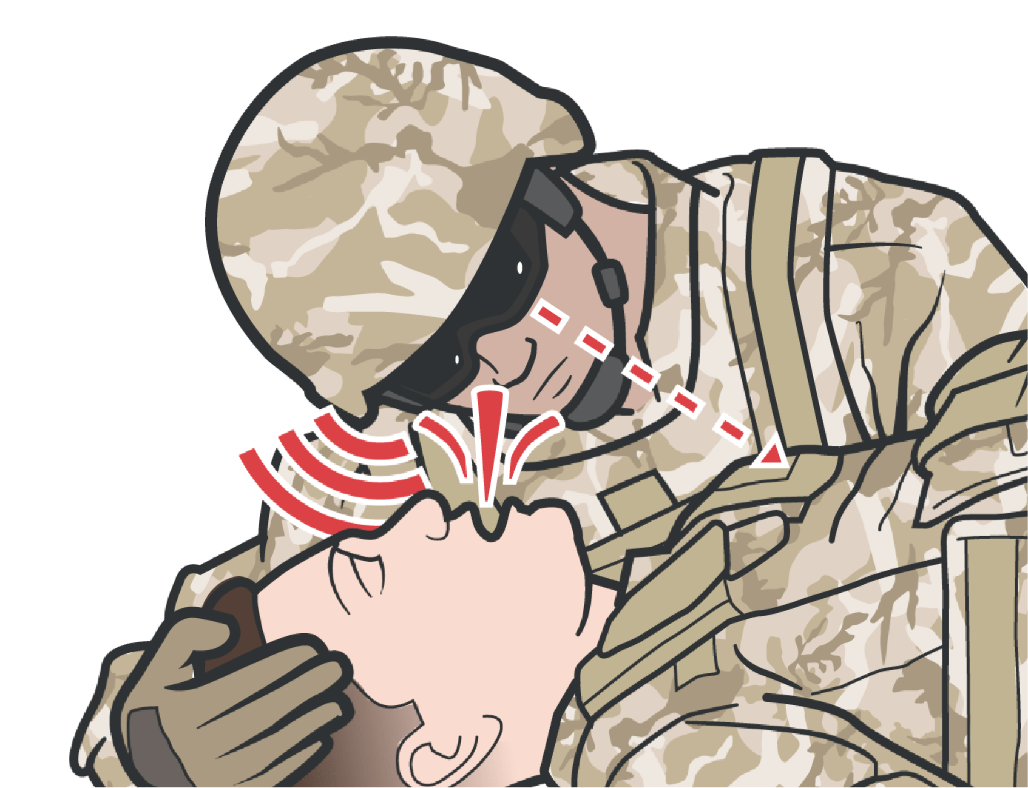
CASUALTY MONITORING
CHECKING RESPIRATIONS
LOOK, LISTEN, and FEEL FOR RESPIRATIONS
If a casualty becomes unconscious or their breathing rate drops below 8 respirations within 1 MINUTE, insert a nasopharyngeal airway
Assess for tension pneumothorax and treat as necessary
Perform needle decompression in the presence of tension pneumothorax
Reassess to confirm that needle decompression of the chest (NDC) was successful

Slide 11
CASUALTY MONITORING
SKILL STATION
Casualty Monitoring Concepts (Skills) Level of consciousness
Radial pulse Carotid pulse Tibial pulse

Slide 12

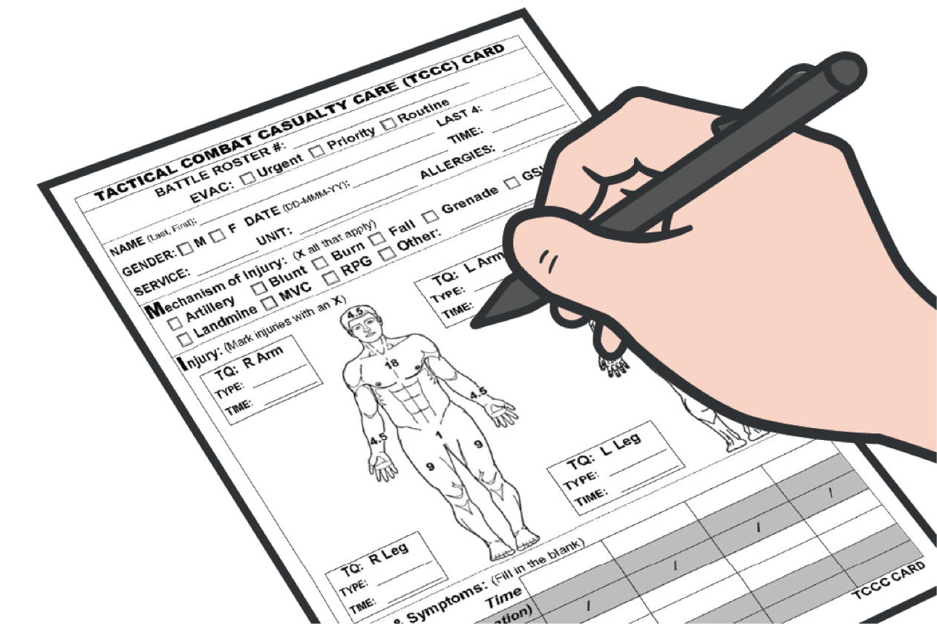

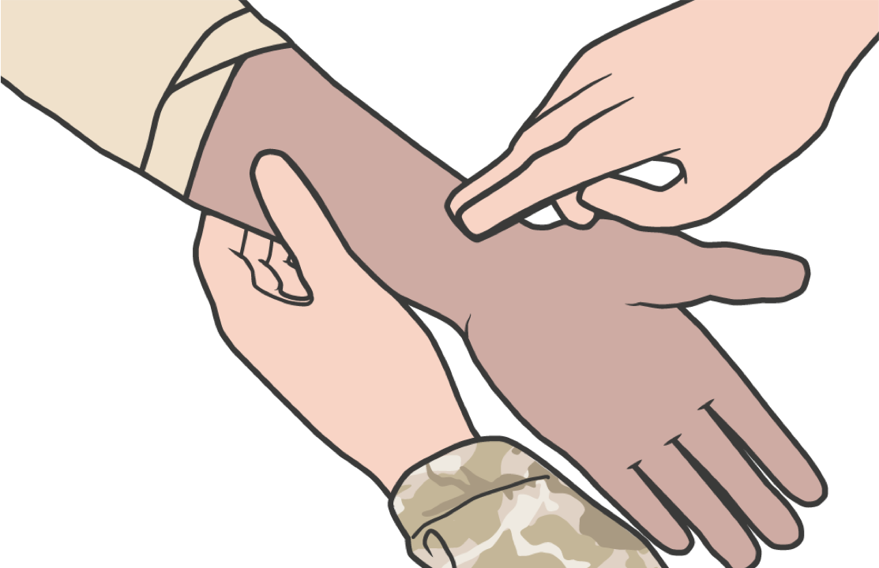
CASUALTY MONITORING
SUMMARY
LOOK, LISTEN, and FEEL FOR RESPIRATIONS
We discussed assessment using MARCH PAWS
We discussed levels of consciousness We discussed checking for pulse
We discussed checking respirations

Slide 13
CHECK ON LEARNING
How is a casualty monitored after the MARCH PAWS sequence has been executed?

Slide 14
ANY QUESTIONS?

